Slide 1


Slide 2
Determination of Shock losses and Pressure losses in U/G mine openings.

Slide 3
Contents:
Introduction
Objective
Scope Of the Project
Literature Review
Leakage and Frictional Losses
Mine openings contributing to Losses
CFD Study
Meshing- Design of Mine geometry using Gambit
CFD Simulation- FLUENT Analysis
Results and Comparison
Conclusion
Suggestions for Future study.

Slide 4
Objective
To Calculate Pressure and Shock Losses in Different Mine openings using CFD Simulation Techniques.
To study the difference between the observations from CFD software and classical formula proposed for calculating losses in different mine configurations.
Validate that CFD simulations of shock losses have improved the prediction and visualization of airflow behavior through mine airways.

Slide 5
Scope Of the Project
The initial phase of CFD modeling involved the simulation of a pilot-scale model of mine geometries which aren’t feasible to model the real-time experiment.
Convert the validated CFD model of the pilot design into a scaled-up model to be used to simulate the full-scale design.
CFD study is used as a replacement of experimental simulation which require lot of time and money for a single case study.

Slide 6
INTRODUCTION
6
To ensure proper mine atmospheric environmental control, adequate quantities of air must flow through working sections in the mine.
The leakage losses are a serious detriment to the efficiency of mine ventilation systems.
Proper assessment of these losses in simulating and projecting complex ventilation systems is vital.
In recent years much attention has been paid the fan and its prime movers, but the efficient use of the fan output in the workings has not received an equal amount of investigation.

Slide 7
Sources of resistance to the flow of a fluid in a pipe:
Viscosity of the fluid
Friction between the fluid and the pipe internal surface
Changes in area and direction of flow
Obstructions in the path of flow

Slide 8
Frictional Pressure Losses
(over 70 % of Pressure losses)
Viscosity of the fluid (neglected)
Friction between the fluid and the pipe
Shock Losses
( 30% of Pressure Losses)
Changes in area and direction of flow
Obstructions in the path of flow
Pressure Losses

Slide 9
Pressure Losses Due To Friction
The major part of the pressure losses in almost any type of air-flow system.
In mechanically ventilated mines the friction losses in the main airways often account for 70 to 90 percent of the total pressure loss sustained in the system.
The only accurate way to determine the friction factor for a given air-way is to compute it from pressure drop and air quantity measurement underground.
They are therefore of considerably greater practical importance than the shock losses as far as mines are concerned.

Slide 10
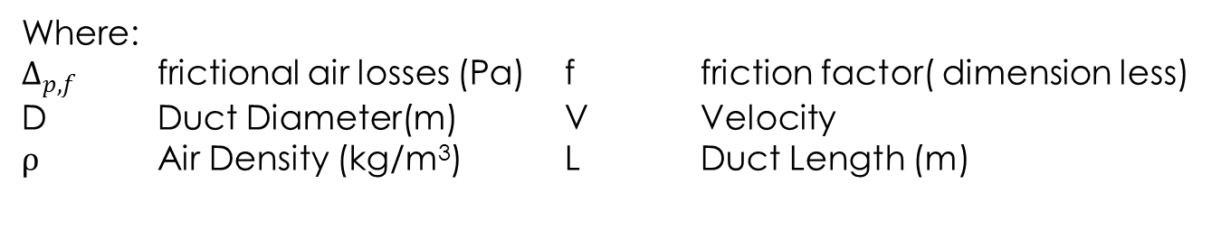
$∆_{p,f}=\frac{1fLV^{2}ρ}{2D}$(Darcy- WeissbachExpression))
Where:
$∆_{p,f}$ frictional air losses (Pa) f friction factor( dimension less)
D Duct Diameter(m) V Velocity
$ρ$ Air Density (kg/m³) L Duct Length (m)

Slide 11
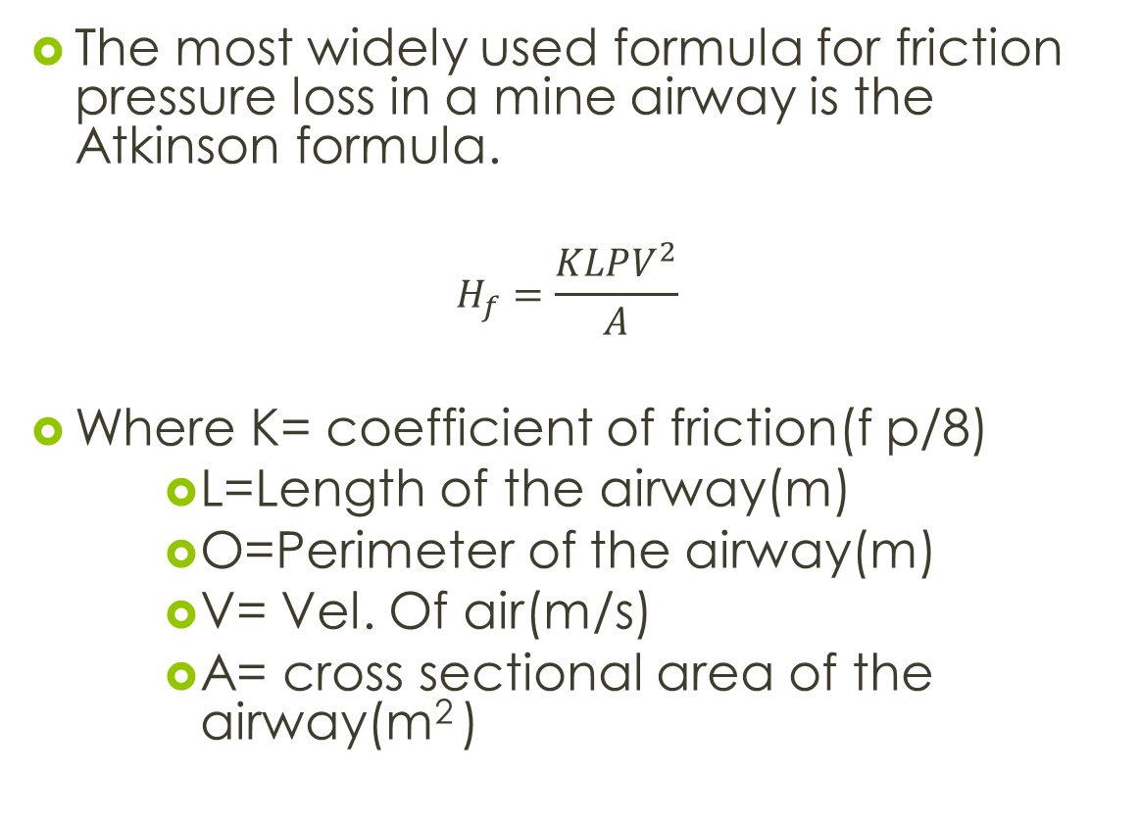
The most widely used formula for friction pressure loss in a mine airway is the Atkinson formula.
$$H_{f}=\frac{KLPV^{2}}{A}$$
Where K= coefficient of friction(f p/8)
L=Length of the airway(m)
O=Perimeter of the airway(m)
V= Vel. Of air(m/s)
A= cross sectional area of the airway(m² )

Slide 12
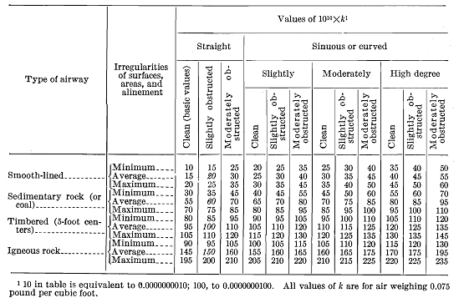
Bureau of Mines schedule of friction factors for mine airways
Source: McElroy, 1935.Note: All values of K are for air weighing 0.0750 Ib/ft. Values in the table are expressed in whole numbers but must be multiplied by 10⁻¹⁰ to obtain the proper K value.

Slide 13
Shock Pressure Losses
Shock losses arise from changes in direction(e.g., bends), changes in cross-sectional areas (e.g., obstructions),or changes in both (e.g., junctions and splits).
Shock losses are independent of the roughness of walls and therefore cannot be computed directly as friction losses.
However, shock losses bear a constant ratio to the velocity pressure corresponding to the mean velocity of flow.

Slide 14
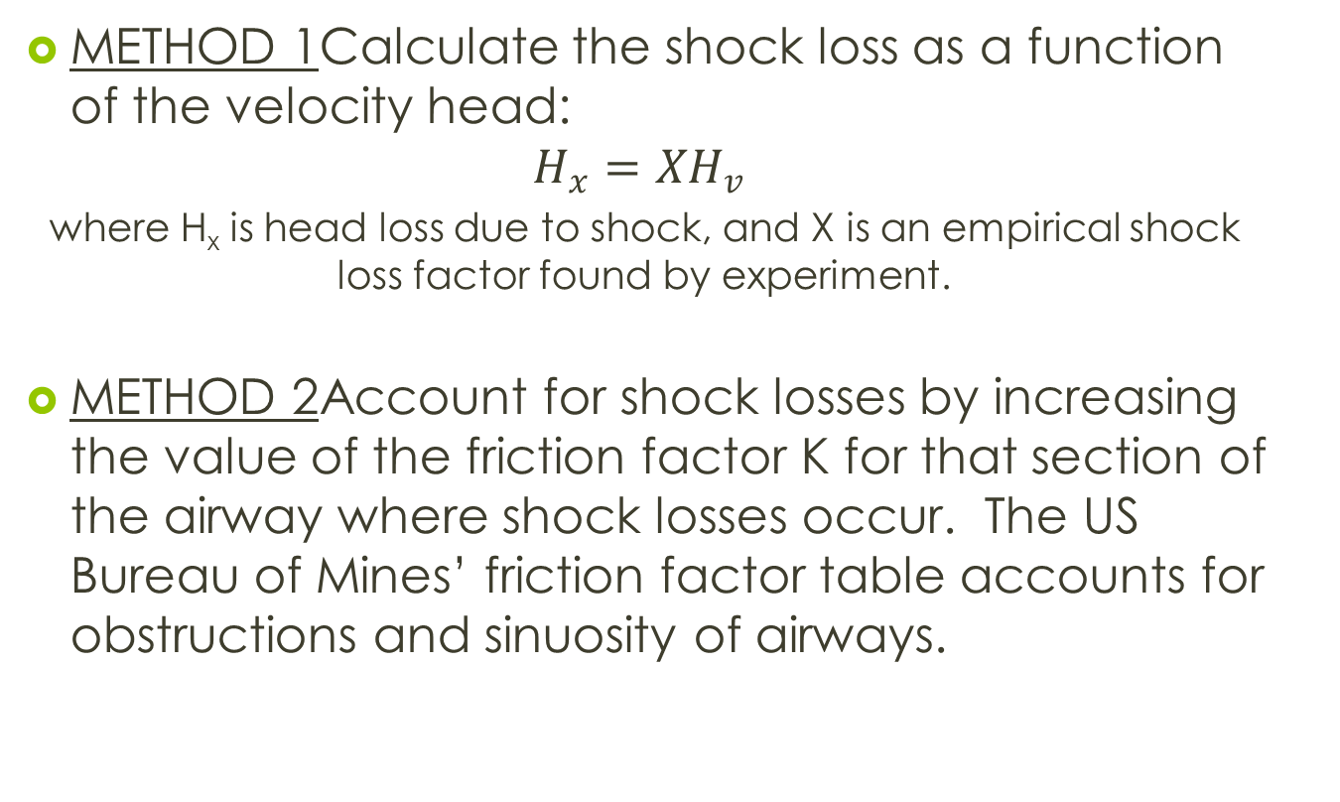
Calculating Shock Losses There are three methods for estimating shock losses:
METHOD 1Calculate the shock loss as a function of the velocity head:
$$H_{x}=XH_{v}$$
where H_{x} is head loss due to shock, and X is an empirical shock loss factor found by experiment.
METHOD 2Account for shock losses by increasing the value of the friction factor K for that section of the airway where shock losses occur. The US Bureau of Mines’ friction factor table accounts for obstructions and sinuosity of airways.

Slide 15
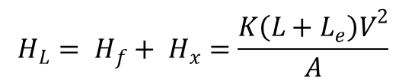
METHOD 3 Account for shock loss by expressing a shock loss condition as an additional length of a straight airway to be added to the given length of the airway. This length is known as the equivalent length, L_{e}. With the equivalent length method, the head loss in an airway H_{L} is obtained by including in the Atkinson equation the equivalent length:
In the above equation , L_{e} is equivalent length in ft (m).
This method is recommended for all routine mine ventilation calculations. Hartman and Mutmansky (1982)
$$H_{L}= H_{f}+ H_{x}=\frac{K\left(L+L_{e}\right)V^{2}}{A}$$

Slide 16
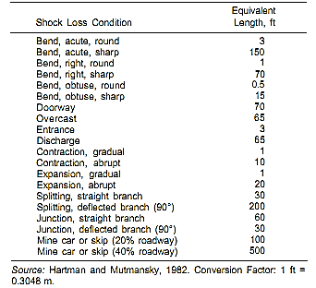
Table: Equivalent Lengths for Various Sources of Shock Loss

Slide 17
Types of Mine Openings and Configurations Contributing to Losses in an Underground Mine

Slide 18
PRESSURE LOSSES ACROSS DIFFERENT MINE OPENINGS AND CONFIGURATION
In this study, seven configurations commonly found in mine ventilation system are stimulated.
For all the simulations, Air density and viscosity were considered to be 1.12 kg/m3 and 1.85 x 10⁻⁵ Pa.s respectively.
It was assumed that airflow in the configuration was incompressible and isothermal.
All the calculations and simulations will be performed with a Reynolds number on the order of 10⁵ in order to replicate the real-life flow situation.

Slide 19
The Mine configurations considered for simulations are:
Mine tunnels
Round Bends
Junctions and Splits
Gradual Contraction
Gradual Expansion
Shaft Bottoms
Regulators

Slide 20
CFD STUDY

Slide 21
WHAT IS CFD?
Computational fluid dynamics (CFD) is one of the branches of fluid mechanics that uses numerical methods and algorithms to solve and analyze problems that involve fluid flows.
Most fundamental consideration in CFD is how a continuous fluid is treated in a discretized fashion on a computer.
Most of the laminar flows are based on Navier-Stokes Equation
RANS method, LES method are used for turbulent flow
More advanced codes allow the simulation of more complex cases involving multi-phase flows

Slide 22
DISCRETIZATION METHODS IN CFD
Finite volume method (FVM) [ Mostly Used for CFD Simulations]
Finite element method (FEM)
Finite difference method
Boundary element method
High-resolution schemes

Slide 23
HOW IS THE WORKING DONE IN CFD
Preprocessing
Definition of the geometry of the region
Definition of fluid properties
Solver
Approximation of unknown flow variables
Discretization
Post-processing
Vector plots
Line & shaded contour plots
2D & 3D surface plots

Slide 24
SOFTWARE USED
Meshing Software
GAMBIT by ANSYS Inc.
CFD Solver and post-processing Tool
FLUENT by ANSYS Inc.

Slide 25
CFD ANALYSIS
Two are the main assumptions to be made that can have a strong inﬂuence in the results:
The mesh density and
The turbulence model.
The meshing process divides the simulation domain in equally shaped volumes where the governing equations of the ﬂuid ﬂow are discretized and solved. Where the pressure or velocity gradients are expected to be high the mesh has to be ﬁne.

Slide 26
Regarding Turbulence model, studies by Song and Han (2005) , Ballesteros-Tajadura et al. (2006), Gimbun et al. (2005) ,Zhang and Chen (2006) and others have shown that k–epsilon model is enough for calculations.
k–epsilon model is widely extended in these CFD applications, and has the enormous advantage that is not as high resource consuming as other RANS methods.
k–epsilon turbulence model is the perfect compromise between accuracy and calculation time and hardware requirements

Slide 27
MESHING – Design of Configurations using GAMBIT

Slide 28
GAMBIT is a software package designed to help analysts and designers build and mesh models for computational fluid dynamics (CFD) and other scientific applications.
GAMBIT receives user input by means of its graphical user interface (GUI).
The profiles are generated with the help of coordinates available which have been generated.
All these mine configurations are finally assembled and meshing is done.

Slide 29
Tunnels
Diameter: 10m
Length : 500m
Simulation domains :600,000 elements of which 170,000 are tetrahedrons
Special Requirement: 14 Tetrahedron in diameter with 10 prisms in the boundary layer

Slide 31
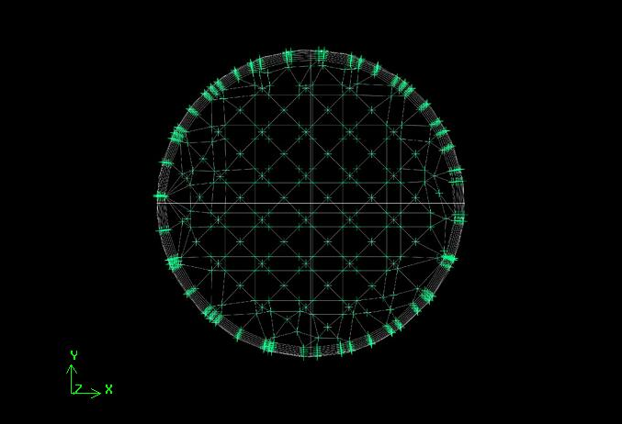

Slide 32
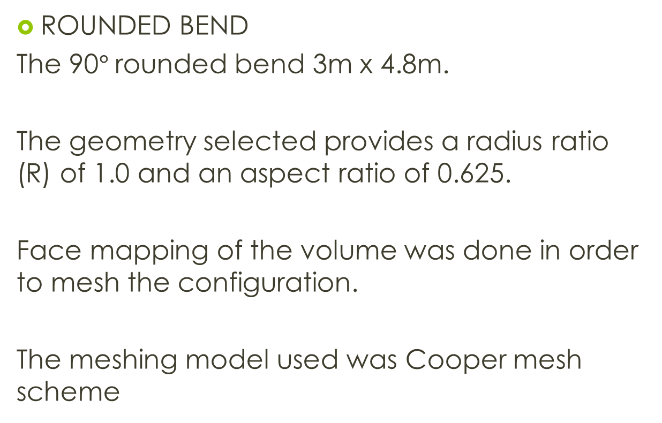
ROUNDED BEND
The 90$°$rounded bend 3m x 4.8m.
The geometry selected provides a radius ratio (R) of 1.0 and an aspect ratio of 0.625.
Face mapping of the volume was done in order to mesh the configuration.
The meshing model used was Cooper mesh scheme

Slide 33
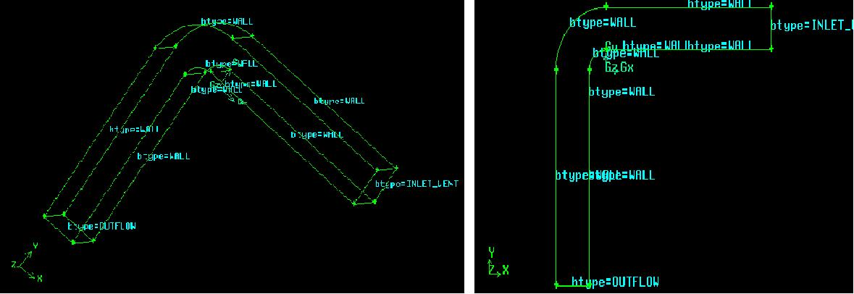

Slide 34
Gradual Expansion And Contraction

Slide 35
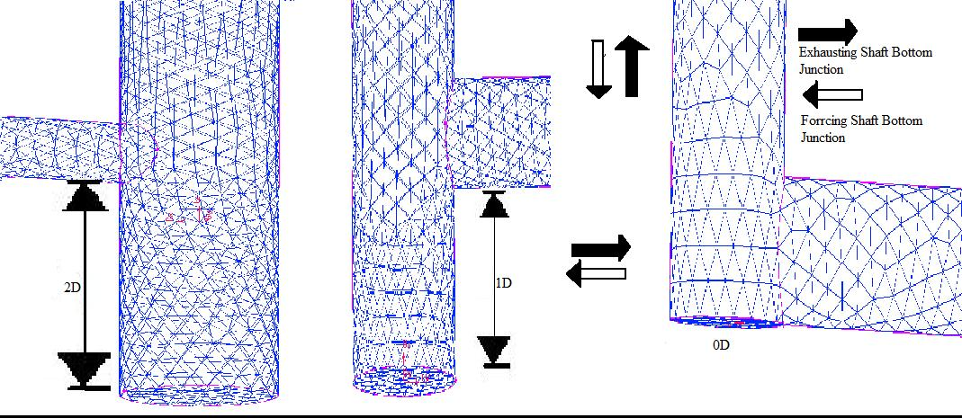
Shaft Bottom
The CFD model was made of a shaft which is 600m deep and diameter of the shaft was 6m.
The Plat dimension was 3m height, 4 m width and was 350 m long

Slide 36
CFD SIMULATION- FLUENT Analysis

Slide 37
Initial Inputs
Material selected is Air.
The properties of Air is taken as follows-
Density = 1.12 kg/m3
Cp (specific heat capacity) = 1.06 J/kg K
Thermal conductivity = 0.0242 W/m K
Viscosity=1.85 x 10⁻⁵Pa.s
K-Epsilon Turbulence Model

Slide 38
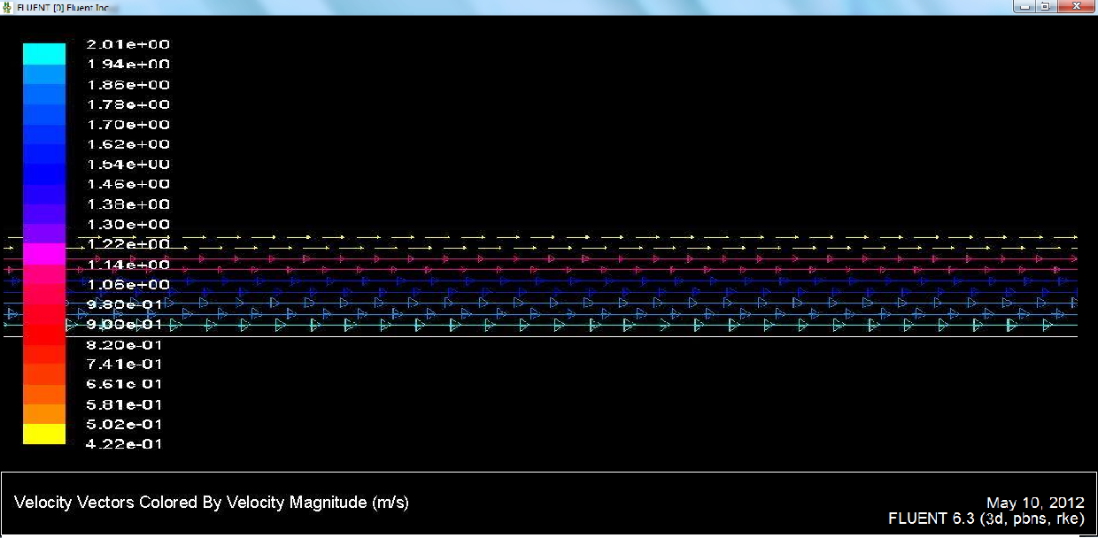
Tunnels
2 simulations for velocity 0.2m/s and 8m/s of a 10m diameter tunnel was done.

Slide 39
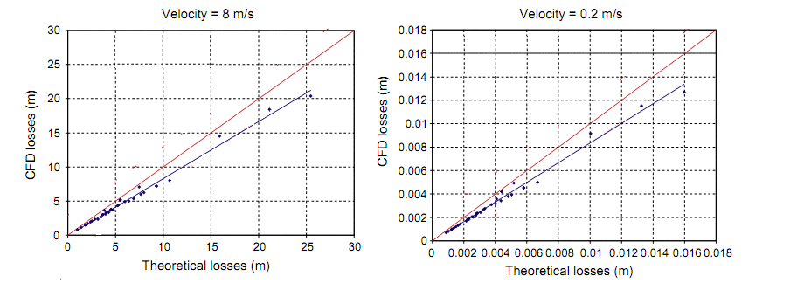
Losses that are obtained when calculating an installation with the CFD method will get losses values nearly 17% lower than if the calculation is done by the theoretical methods.

Slide 40
Simulation Results for Gradual Contraction
Model Parameters of Gradual Contraction Configurations
Model parameter | Value
Upstream length (m) | 15
Downstream length (m) | 15
Cross section area(m²); upstream, contraction and downstream | 1.00, 0.25,0.25
Mean uniform inlet velocity (m/s) | 3
Reynolds number | 1.82 x 10⁵
Grid size (cells, faces, nodes) | 30400, 97380, 36905

Slide 41
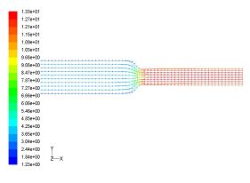
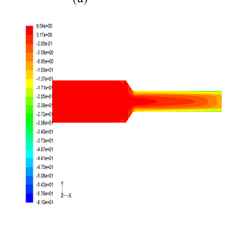
a) Velocity (m/s) Vector Plot
b) Total Pressure Plot (Pa)

Slide 42
Simulation Results for Gradual Expansion
Model Parameters of Gradual Expansion Configurations
Model parameter | Value
Upstream length (m) | 15
Downstream length (m) | 15
Cross section area(m²); upstream, contraction and downstream | 0.25,0.25 and 1.0
Mean uniform inlet velocity (m/s) | 3
Reynolds number | 0.9 x 10⁵
Grid size (cells, faces, nodes) | 30400, 97380, 36905

Slide 43
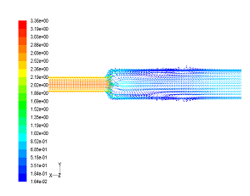
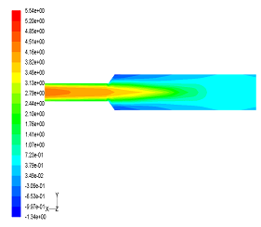
(a) Velocity (m/s) Vector Plot
(b)Total Pressure Plot (Pa)

Slide 44
Simulation Results for a Mine Regulator
Model Parameters of Mine Regulator
Model parameter | Value
Upstream length (m) | 15
Downstream length (m) | 15
Airway Width, Height Regulator width, Height and Length (m) | 0.6,0.2 0.15,0.12, and 0.02
Mean uniform inlet velocity (m/s) | 3
Reynolds number | 0.5 x 10⁵
Grid size (cells, faces, nodes) | 28806, 96113, 39130

Slide 45
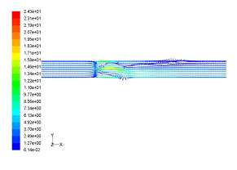
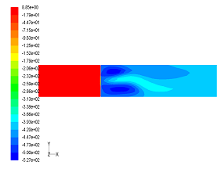
(a) Velocity (m/s) Vector Plot
b)Total Pressure Plot (Pa)

Slide 46
Simulation Results for Shaft Bottom
Input parameters of CFD Model of the Shaft
Boundary Conditions Exhausting Configuration: Forcing Configuration: Geometry: Shaft Diameter: 6m Plat Dimensions: Hydraulic Diameter: 3.4m Airway Relative Roughness (e/D): Other Parameters: Viscosity Model: Wall Function : Fluid: Density: Viscosity: Re for the airflow in shaft: | Airway Entry Velocity: 4.6m/s Shaft Outlet Pressure: -800Pa Airway Inlet Operating Pressure: 1 atm Shaft Entry Velocity :1.5m/s Airway Outlet Operating Pressure: 1 atm Shaft Length: 600m Shaft Bottom Length: 0xD,1xD,2xD 3m x 4m (height x width), 350m(length) 0.003,0.023,0.053 K-Epsilon Model Standard Wall Function Air 1.2 kg/m³ 1.85 x 10⁻⁵ Pa.s 5.4 x 10⁵

Slide 47
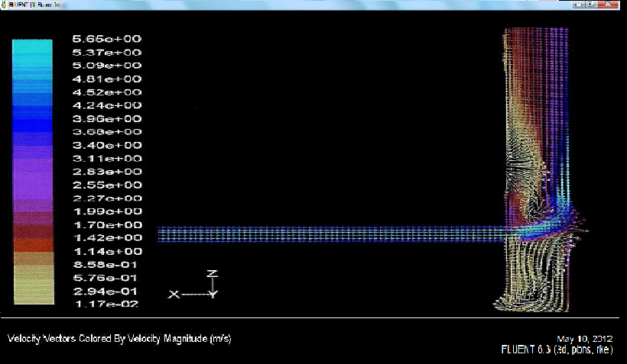

Slide 48
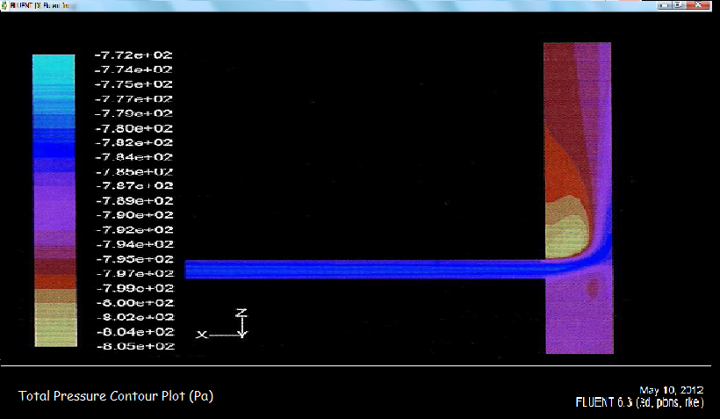

Slide 49
Results and Comparison
From results in the previous section, we can observe that there is difference between Pressure and Shock losses in Various Mine Configurations observed by calculations from software packages Fluent and the published literature.
The values obtained by calculating pressure losses in a tunnel using CFD study had seen an error of 17% than the pressure losses obtained from classical formula.
Moreover, the flow properties of fluid in a mine can be predicted using CFD.

Slide 50
The shock losses at shaft bottoms did match with the earlier experimented values but some sort of discrepancy was observed in Forcing shaft bottom. This discrepancy could have been because of choosing K-Epsilon model or may be due to wrong meshing of the model.
For two-way junctions, the literature underestimates the shock loss coefficient substantially for both the branches by 50% or more. In case of two-way splits, the literature underestimates the shock loss coefficient for the straight branch by 20% or more.

Slide 51
Table Comparison of Shock Loss Coefficients
Configuration | Shock Loss Factor value from CFD simulation | Shock Loss Factor values for similar configurations from published literature (McElroy,1935)
Rounded bend | 0.18 | 0.13
Gradual contraction | 0.14 | 0.15
Gradual expansion | 0.42 | 0.56
Regulator | 80.45 | 90.22

Slide 52
Conclusion
From the results , it can be seen that there is good agreement between CFD-generated shock loss coefficients values and the published values of similar configurations in published literatures, except in case of splits/junction and forcing shaft bottom. The reasons for disagreement in these cases may be as follows: The k - e turbulence model was not able to model the behavior of airflow through abrupt contraction. Improper meshing of the mine configuration.
3D simulation for such calculations, since 3D simulation are more near to the reality

Slide 53
3D simulation for such calculations, since 3D simulation are more near to the reality .
Also, 3D simulation gives more clear view of swirl movements, streamlines and turbulence in the ﬂuid.
During the work we realized that Fluent is a better option for heavy and precise simulations. Since, Fluent has capability to model turbulence with verity of Kappa-Epsilon models and also because Gambit is a very handy tool to create even complicated geometries.

Slide 54
Future Scope Of Studies
No Classical formula consider the roughness of the pipe. This is where the accuracy of coefﬁcients obtained by classical formula can be questioned. Though the loss due to friction between ﬂuid and junction inner surface is very less but these small values can be very signiﬁcant for precise calculations
There should be more 3D computational experiments done using more advanced CFD software packages.
Since Fluent takes too much time with dynamic mesh, but this is possible with higher versions of Fluent and other CFD packages.
The use of other complex turbulence method like RANS and LES model can be used for Pressure and shock loss calculation.

Slide 55
References:
I Diego, S Torno, J Toraño, M Menéndez, M Gent,” A practical use of CFD for ventilation of underground works”, Tunnelling and Underground Space Technology Vol.26 (2011) ,pp189–200.
T.Purushotham and S.Bandopadhyay, 2009, “Estimation of Shock Loss Coefficiant Values for mine Ventilation Configurations using CFD Simulations”, Proceedings,9th IMVC,New Dehli,,India,2009.
Fluent Inc. 2007. Fluent users guide, USA.
McElroy, G.E., 1935, “Engineering factors in the ventilation of metal mines”
Jade, R.K. and Sastry, B.S., 2008. “An experimental and numerical study of two-way splits and junctions in mine airways”, Proceedings,12th US Mine Ventilation Symposium, Reno, Nevada, USA, pp 293-297.
T.Purushotham, B.S.Sastry, and B.Samanta. 2010. “Estimation of shock loss factors at shaft bottom junction using computational fluid dynamics and scale model studies. “ CIM Journal, Vol.1, No.2.
Sinha, A. K. ; Das, R. S. “Comparison of mine ventilation system computer - analysis and measurements made in simulated physical model “

Slide 56
McPherson, M.J., 2007. Subsurface Ventilation and Environmental Engineering. Springer.
Blazek, J., 2001. Computational Fluid Dynamics: Principles and applications.Elsevier Science Ltd., United Kingdom. p. 225.
Launder, B.E., Sharma, B.I., 1974. Application of the energy dissipation model of turbulence to the calculation of ﬂow near a spinning disc. Letters in Heat and Mass Transfer 1 (2), 131–138.
Song, Hyun-Seob, Han, Sang Phil, 2005. A general correlation for pressure drop in a Kenics static mixer. Chemical Engineering Science 60, 5696–5704.
Versteeg, H.K., Malalsekeera, W., 1995. An Introduction to Computational Fluid Dynamics. Longman Group Ltd., Harlow, UK.
Zhang, Z., Chen, Q., 2006. Experimental measurements and numerical simulations of particle transport and distribution in ventilated rooms. Atmospheric Environment 40, 3396–3408.
www.smenet.org (Accessed on various dates between August,2011 till date)
www.onemine.org (Accessed on various dates between August,2011 till date)
www.sceinecedirect.com (Accessed on various dates between August,2011 till date)

Slide 57
THANK YOU!!

Slide 58
BACK UP SLIDES

Slide 59
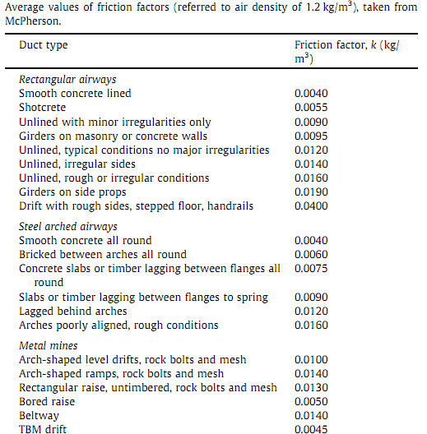
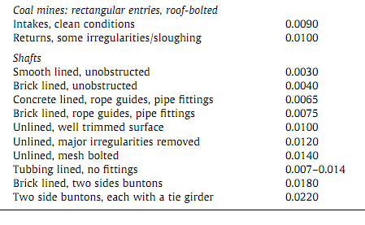
BACK UP SLIDES

Slide 60
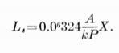
They also recommend the following procedure for its use:
BACK UP SLIDES
Values of Le from Table need not be corrected for K or RH.
With a change in area (splitting not involved), shock loss is included in the airway section following the change. This also applies to a bend in conjunction with an area change. Separate values are provided for shock losses at entrance and discharge.
At splits and junctions in airways, only the portion of the total flow involved in a change of direction or area is used. Values from Table assume an even division of flow and allow for bend and area change. Include the loss at a split or junction in the pressure drop for the particular branch.
Judgment must be exercised in making proper allowance for unusual sources of shock loss such as obstructions. Values from Table are sufficiently accurate for all routine work. For more precise calculations, such as would be required for research, the following formulas should be used (McElroy, 1935):

Slide 61
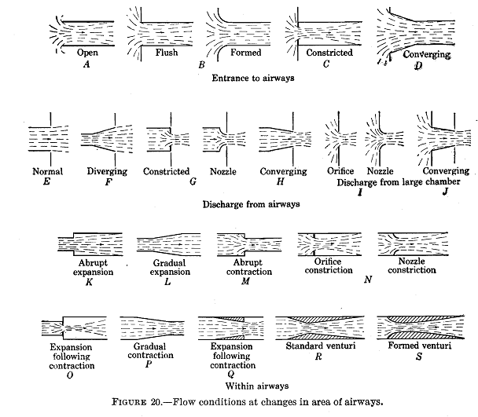
BACK UP SLIDES

Slide 62
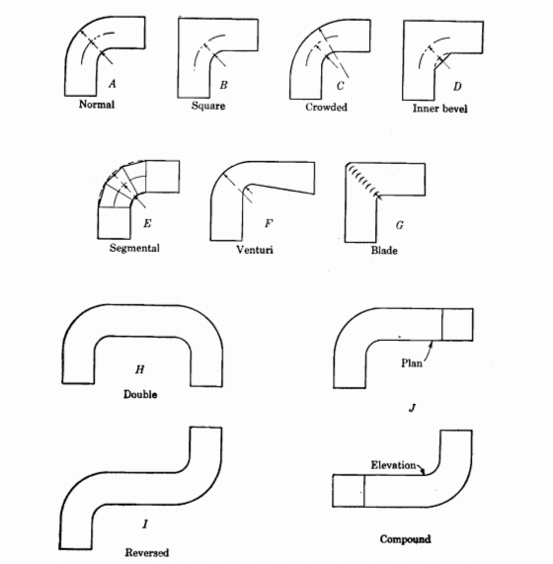
BACK UP SLIDES

Slide 63
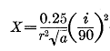
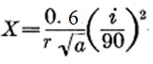
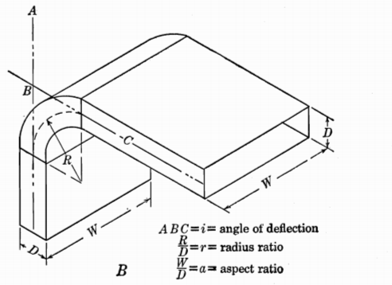
BACK UP SLIDES
For Square bends

Slide 64
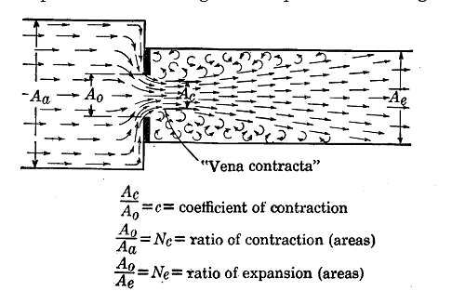
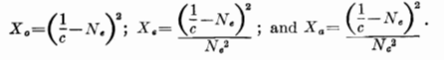
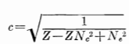
BACK UP SLIDES

Slide 65
CFD Simulated Shock loss factors for forcing shaft bottom junction
Roadway Roughness |  |  | Shock Loss Factor |  |  | Mean Shock Loss Factor
 |  |  | Shaft Bottom Length
e/D | f | k (kg/m³) | 2xD | 1xD | 0xD
0.003 | 0.004 | 0.0024 | 3.30 | 3.40 | 3.03 | 3.25
0.023 | 0.013 | 0.0078 | 4.17 | 4.17 | 3.23 | 3.86
0.053 | 0.018 | 0.0111 | 4.45 | 4.20 | 3.24 | 3.96
Mean Shock Loss Factor |  |  | 3.97 | 3.92 | 3.17 | 3.69
By using Moody’s Diagram we can convert relative roughness to f ( chezy darcy coefficient) or k (atkinson’s friction factor)
CFD Simulated Shock loss factors for exhausting shaft bottom junction
Roadway Roughness |  |  | Shock Loss Factor |  |  | Mean Shock Loss Factor
 |  |  | Shaft Bottom Length
e/D | f | k (kg/m³) | 2xD | 1xD | 0xD
0.003 | 0.004 | 0.0024 | 7.78 | 8.01 | 7.05 | 7.61
0.023 | 0.013 | 0.0078 | 8.21 | 8.40 | 8.96 | 8.49
0.053 | 0.018 | 0.0111 | 8.38 | 8.55 | 9.38 | 8.77
Mean Shock Loss Factor |  |  | 8.12 | 8.32 | 8.46 | 8.30
By using Moody’s Diagram we can convert relative roughness to f ( chezy darcy coefficient) or k (atkinson’s friction factor)

Slide 69
Comparison of Shock loss coefficient of deflected branch for smooth duct, two-way junction with literature standards
Two-way Junction
Q_{straight} / Q_{main} (%) |  |  | X-Deflected | % deviation
 | CFD |  | Hartman(1982)
10 | 62.577 | -105.156 |  | 268.0
20 | 27.743 | -12.997 |  | 146.8
30 | 16.429 | -2.618 |  | 115.9
40 | 11.225 | 0.032 |  | 99.7
50 | 7.955 | 0.881 |  | 88.9
60 | 5.855 | 1.195 |  | 79.6
70 | 4.229 | 1.318 |  | 68.8
80 | 3.261 | 1.363 |  | 58.2
90 | 2.336 | 1.378 |  | 41.0
Comparison of Shock loss coefficient of straight branch for smooth duct, two-way junction with literature standards
Two-way Junction
Q_{straight} / Q_{main} (%) |  |  | X-Straight | % deviation
 | CFD |  | Hartman(1982)
80 | 1.698 | 1.731 |  | -2.0
70 | 2.923 | 2.244 |  | 23.3
60 | 4.973 | 3.047 |  | 38.7
50 | 8.147 | 4.358 |  | 46.5
40 | 13.793 | 6.743 |  | 51.1
30 | 24.922 | 11.860 |  | 52.4
20 | 57.157 | 25.996 |  | 54.5
10 | 210.801 | 99.613 |  | 52.7

Slide 70
Comparison of Shock loss coefficient of straight branch for smooth duct, two-way split with literature standards
Two-way Split
Q_{straight} / Q_{main} (%) |  |  | X-Deflected | % deviation
 | CFD |  | Hartman(1982)
21 | 23.668 | 21.103 |  | 11
25 | 15.840 | 14.168 |  | 11
36 | 8.421 | 6.420 |  | 24
51 | 3.373 | 3.265 |  | 3
62 | 2.488 | 2.431 |  | 2
66 | 2.166 | 2.239 |  | -3
72 | 1.975 | 2.011 |  | -2
80 | 1.657 | 1.838 |  | -11
99 | 0.788 | 1.636 |  | -108

Slide 71
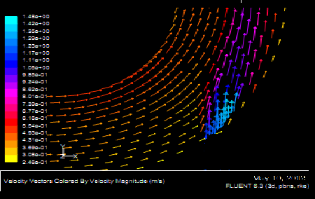

Slide 72
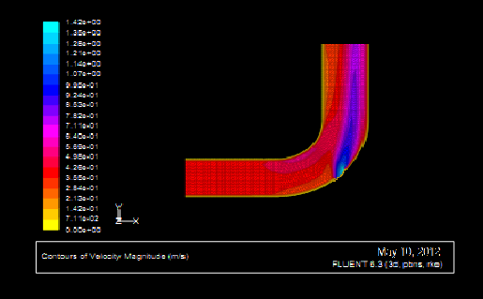

Slide 73
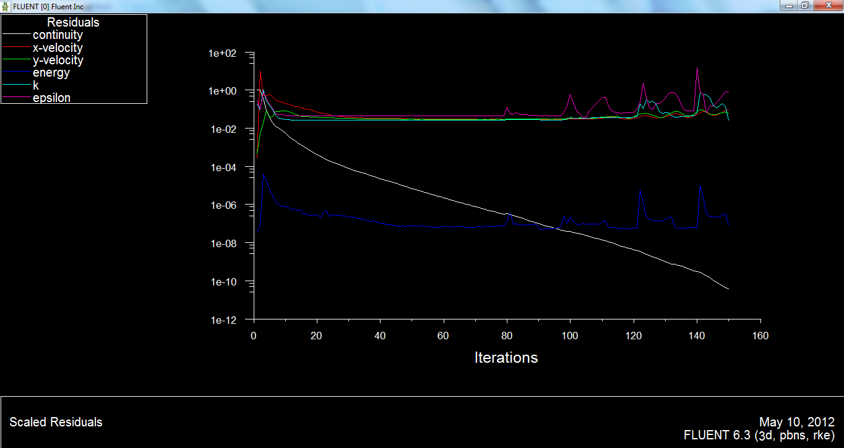

Slide 74
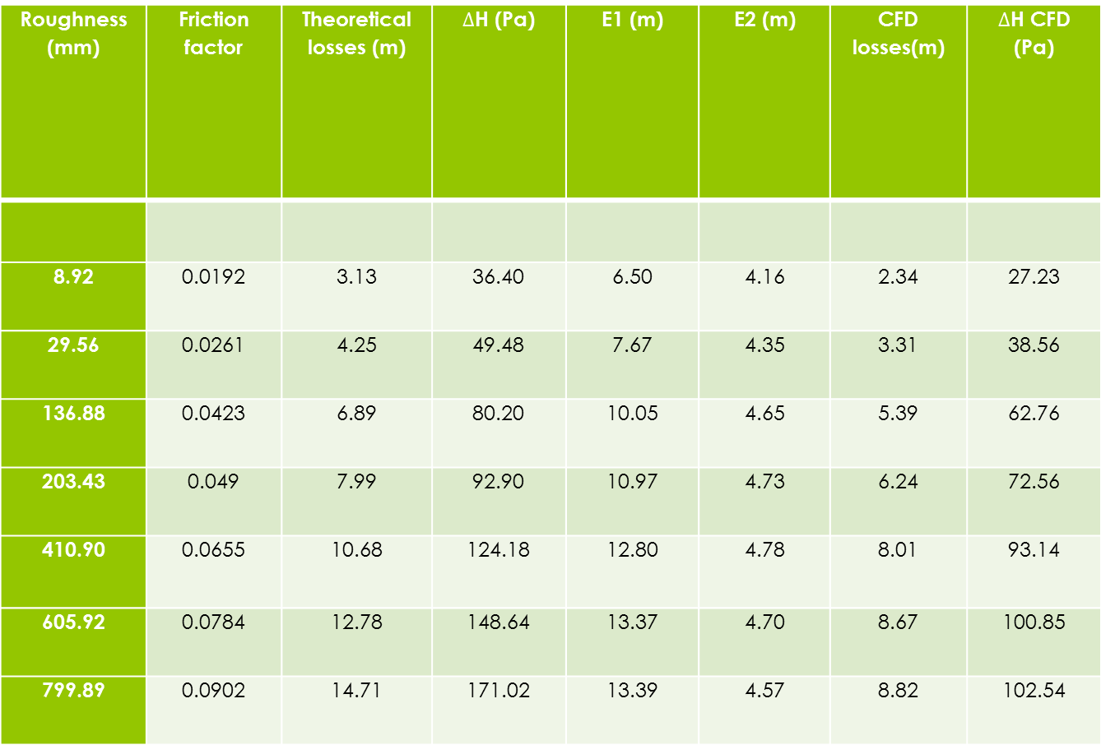
Calculation results (10 m of diameter and 8 m/s of velocity).
Roughness (mm) | Friction factor | Theoretical losses (m) | $∆$H (Pa) | E1 (m) | E2 (m) | CFD losses(m) | $∆$H CFD (Pa)
8.92 | 0.0192 | 3.13 | 36.40 | 6.50 | 4.16 | 2.34 | 27.23
29.56 | 0.0261 | 4.25 | 49.48 | 7.67 | 4.35 | 3.31 | 38.56
136.88 | 0.0423 | 6.89 | 80.20 | 10.05 | 4.65 | 5.39 | 62.76
203.43 | 0.049 | 7.99 | 92.90 | 10.97 | 4.73 | 6.24 | 72.56
410.90 | 0.0655 | 10.68 | 124.18 | 12.80 | 4.78 | 8.01 | 93.14
605.92 | 0.0784 | 12.78 | 148.64 | 13.37 | 4.70 | 8.67 | 100.85
799.89 | 0.0902 | 14.71 | 171.02 | 13.39 | 4.57 | 8.82 | 102.54

